Slide 1
Quality of Care Reviews
Presented to: Board Quality Committee
Date: February 2023
Presented by: Brian Smith, VP Patient Care

Slide 2
What is a critical incident?
An unintended event that occurs when health services are provided to an individual and results in a consequence to him or her:
Serious and undesired, such as death, disability, injury or harm, unplanned admission to hospital or unusual extension of a hospital stay, and
Does not result from the individual’s underlying health condition or form a risk inherent in providing health services

Slide 3
What is a critical incident?
Some examples:
Being operated on the wrong side or site
Receiving the wrong medication or wrong dose of medication that results in serious harm to the patient
“Breakdowns” in communication during transitions of care that result in serious harm to the individual
Delaying treatment or not receiving treatment when this results in a preventable adverse outcome to the patient

Slide 4
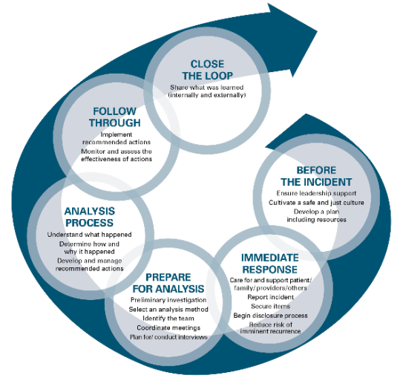
Quality Root Cause Analysis (QRCA)

Slide 5
Quality Root Cause Analysis
Before the Incident:
Ensure Leadership support
Cultivate a safe and just culture
Develop a plan
Immediate Response:
Care for and support patient/family/providers/other
Report incident
Secure items
Begin disclosure process
Reduce risk of imminent recurrences

Slide 6
Quality Root Cause Analysis
Prepare for Analysis:
Preliminary Investigation
Select an analysis method
Identify the team
Coordinate meeting
Analysis Process:
Understand what happened
Determine how and why it happened
Develop and manage recommended actions

Slide 7
Quality Root Cause Analysis
Follow Through:
Implement recommended actions
Monitor and assess the effectiveness of actions
Close the Loop:
Share what was learned
Medical Quality Assurance Committee (MQA) – tasked with monitoring completion of action plans
Board Quality – QRCA’s reported and action plans are shared

Slide 8
Quality Root Cause Analysis
Human factors Staffing Scheduling Orientation/training Competency assessment Supervision Qualification/requirements | Equipment Factors Preventive maintenance Equipment failure Equipment availability Defective equipment User error
Information Factors Accurate data Through and available data Unclear data/information Lack of Technology | Communication Factors Among staff Between staff and patient or family Between physician and staff Between physician and patient or family Between levels of care, units or external facilities
Environmental Factors Physical Cultural Uncontrollable external Environmental risks Quality control Safety, security, utility, HAZMAT, emergency preparedness | Policy, Procedure and Practice Factors Assessment, reassessment, monitoring Care planning Patient/family education Care and treatment protocols and practices Patient identification Patient observation
System Factors and Processes that can contribute to a negative patient outcome:

Slide 9
Quality Root Cause Analysis
The Action Plan will address: (Role of MQA)
Responsibility for implementation
Oversight
Testing as appropriate
Time lines
Strategies for measuring the effectiveness of the actions
Notes:
Oversight – will ensure outstanding actions are completed

Slide 10
Quality Root Cause Analysis
A Quality Root Cause Analysis is not a meeting to lay blame, counsel staff or create feelings of inadequacy/share.
This is a systems review. If any disciplinary issues are identified, they are dealt with separately, and are not ever reviewed within a QRCA

Slide 11
Quality Root Cause Analysis (QRCA)
Board Quality Oversight
MQA’s Oversight

Slide 12
Questions?

